Slide 1


E-learning App with Flutter
Unlock the potential of Flutter to create a dynamic, user-friendly e-learning application that transforms the way users engage with education. Effortlessly incorporate features like course exploration, user authentication, session management, and job discovery to provide a comprehensive learning experience. Enable users to easily browse and enroll in courses, participate in live sessions, and access recorded content, all while receiving timely notifications and updates. Deliver an exceptional platform that empowers learners to take control of their education and career advancement.

Slide 2

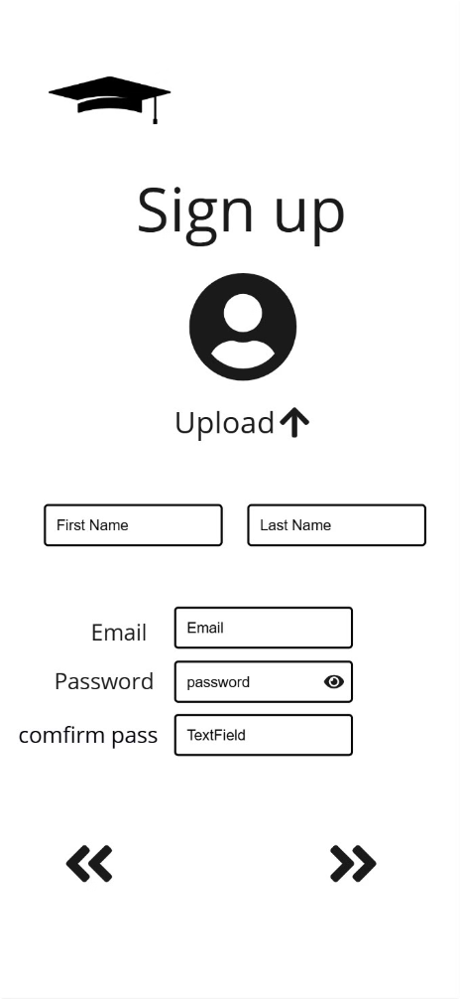
Registration Screen
Account Creation
Validation
Users can set up accounts by entering essential details, such as their email address and preferred password.
The app verifies that email addresses and passwords meet the required format, ensuring a smooth and reliable signup experience for users.
Seamless Integration
Upon successful registration, users are automatically redirected to the login screen, enabling them to quickly access the platform.

Slide 3
Login Screen
Email and Password Login
Google Sign-In
Password Reset
The login screen provides a conventional option for users to access their accounts by entering their email addresses and passwords.
To facilitate quick and convenient access, users can sign in using their Google account.
If users forget their password, they can effortlessly request a reset link through email.

Slide 4

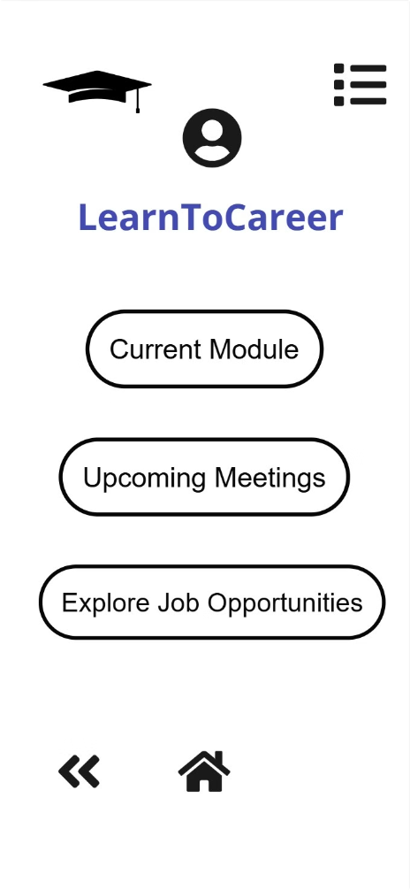
Home Screen
1
Course Catalog
The home screen showcases a curated catalog of educational courses, allowing users to easily explore available options.
User-Friendly Design
The interface is designed to be intuitive and easy to navigate, significantly enhancing the user's browsing experience.
Dynamic Content
The courses displayed are dynamically retrieved from Firebase, ensuring a continuously updated catalog that reflects the latest offerings.

Slide 5
Course Detail Screen
Detailed Course View
When a user selects a course, a dedicated screen offers an in-depth view that includes the course description, pricing, and availability.
User Engagement
This information-rich presentation ensures that users have all the necessary details to make informed decisions about enrolling in a course.

Slide 6


Project Team
Mohamed Salah El-din Ahmed
Rahma Mohamed Taha
Engy Abdelmalak Khillah
هبه الله أحمد مصطفى صالحين
Jana Mohamed

Slide 7

Thank You

